Slide 1
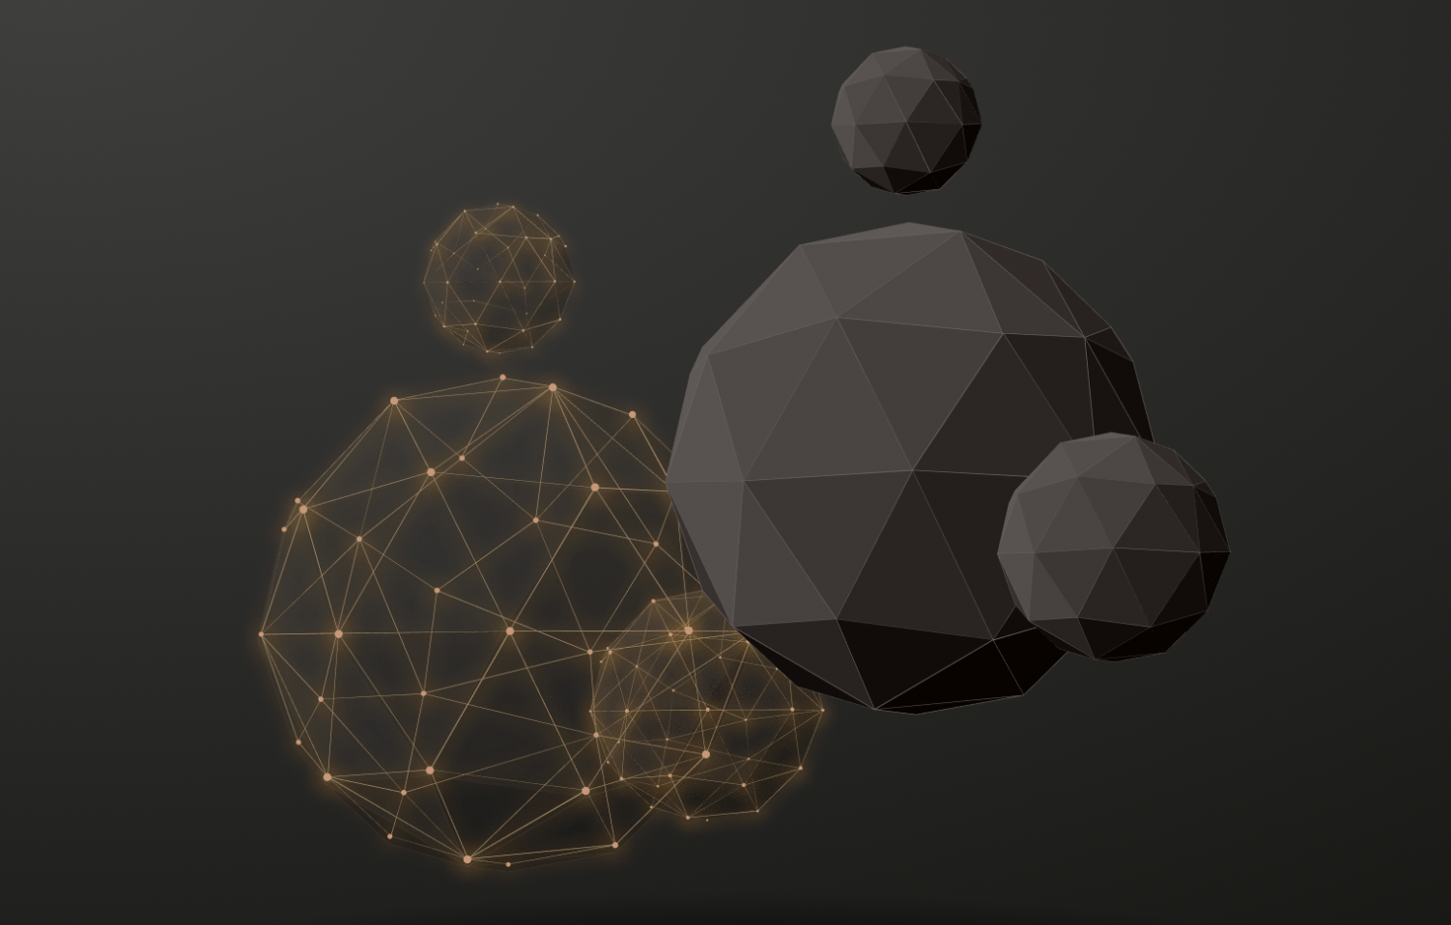
Final Briefing of Group 3 20230608
111.2_人工智慧 邱垂昱 教授 Artificial Intelligence
Using Core competencies of ChatGPT to help quickly understand articles
ChatGPT
ChatPDF
ChatDOC

Slide 2
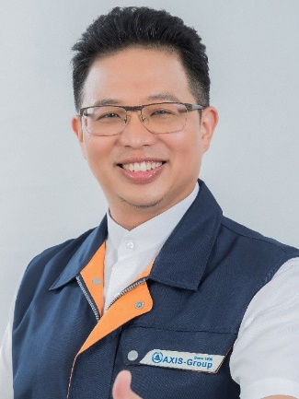
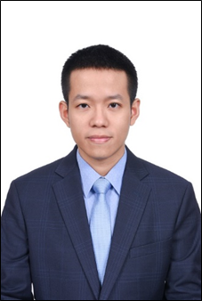
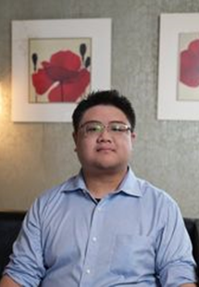
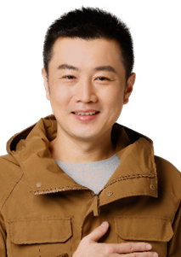
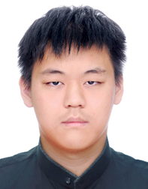

Team Members
Team member List & assignments
陳俊華 Kirin Chen | 何哲平 Ace Ho | 賴炳宏 | 張錦豪 Jing Hau Chang | 黃聿君 Yu Jyun Huang | Shirley Ngo Hong Ngoc
工管博二 | 創新碩一 | 資財碩二 | 工管博二 | 資財碩二 | 工工博三
110749018 | 111C71008 | 110AB8023 | 110749004 | 110AB8028 | 109379403
Organizer | Presenter Chapter 3 | Chapter 1 | Chapter 2 | Chapter 4 | Chapter 5

Slide 3
Index of Briefing
1. Introduction of ChatGPT
2. Three ways to use ChatGPT
3. Practical instructions
4. Advantages and disadvantages
5. Conclusion

Slide 4
1. Introduction of ChatGPT
賴炳宏

Slide 5
Introduction of ChatGPT

Slide 6
2. Three ways to use ChatGPT
張錦豪 Jing Hau Chang

Slide 7
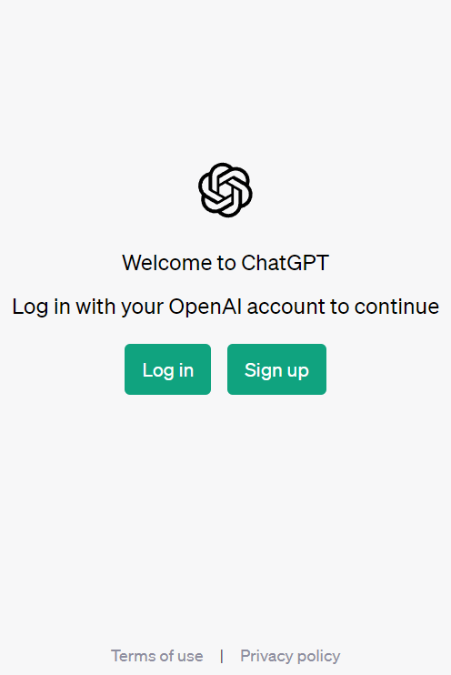
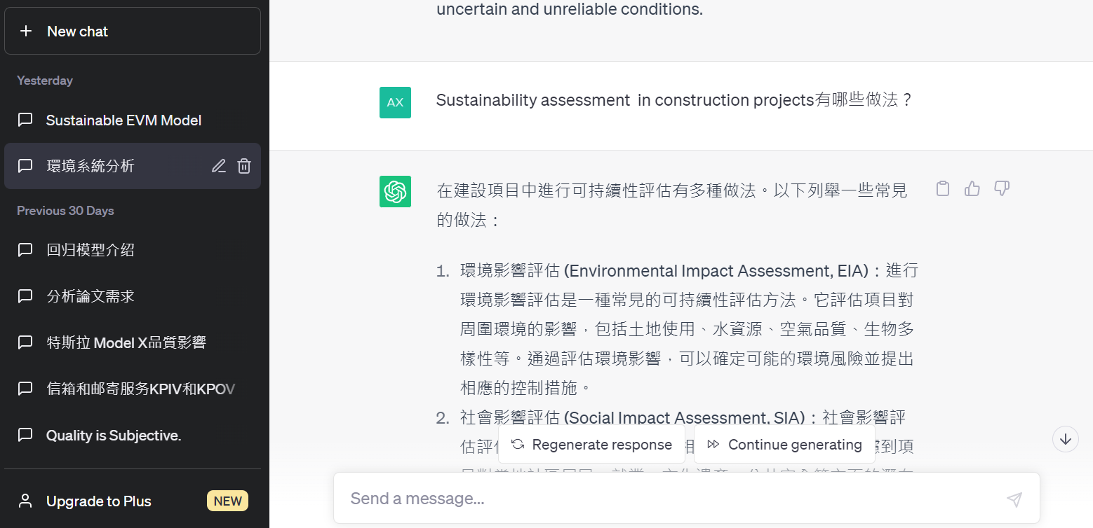
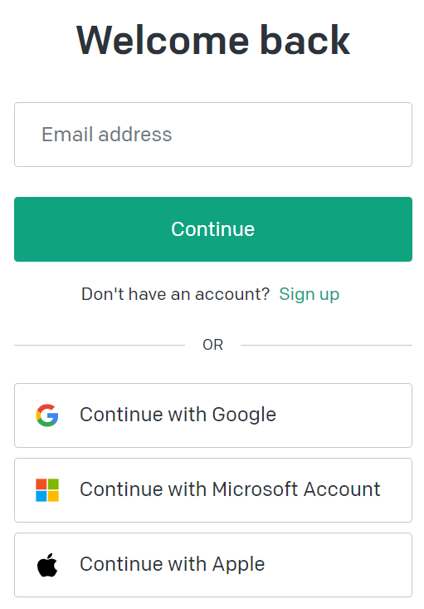
Three ways to use ChatGPT
ChatGPT
https://chat.openai.com/auth/login
Step 1：
Step 5：Need more. Send “ Go on”
Step 2：
Step 4：Send
Step 3：Send a Message

Slide 8
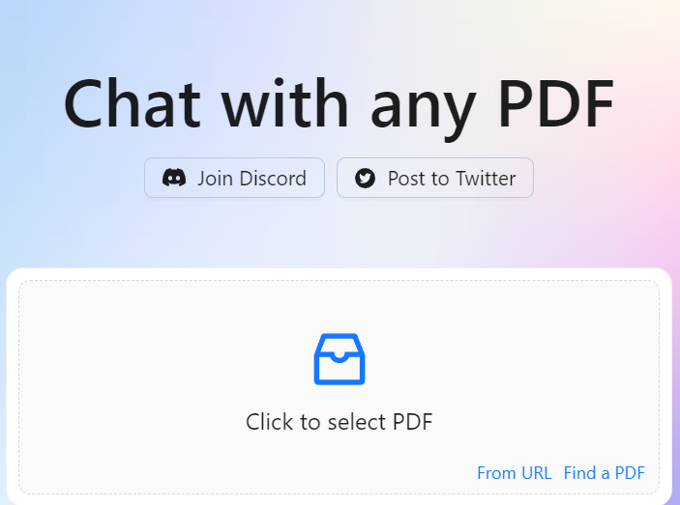
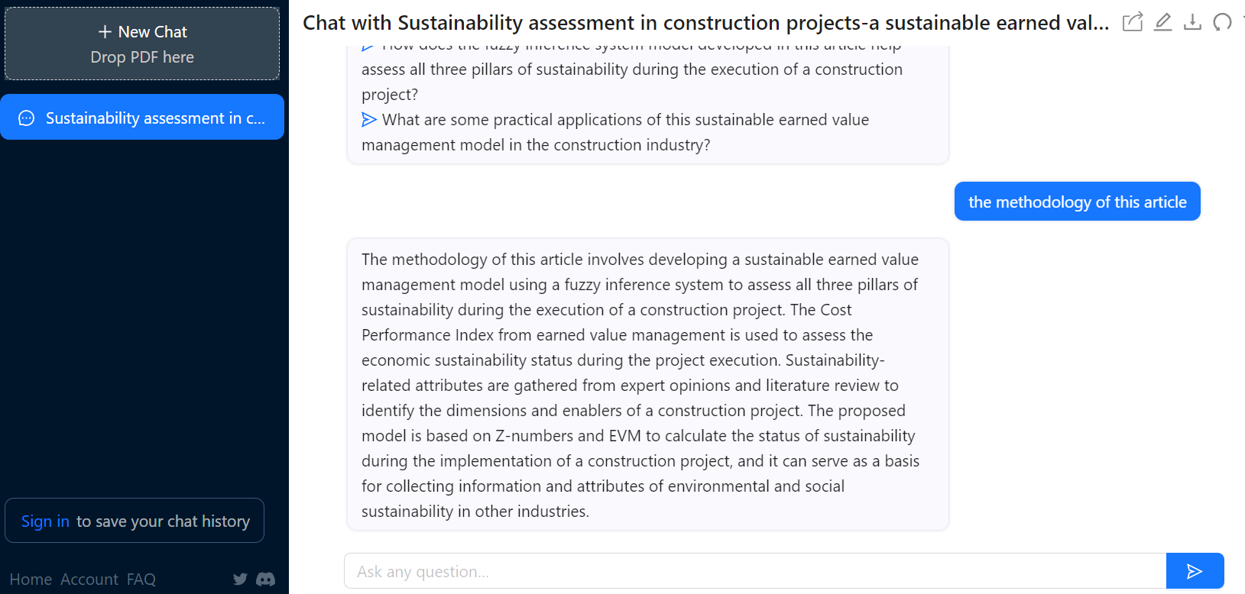
Three ways to use ChatGPT
ChatPDF
https://www.chatpdf.com/
Step 1：Upload PDF file
Step 3：Send
Step 2：Ask any question about this PDF

Slide 9
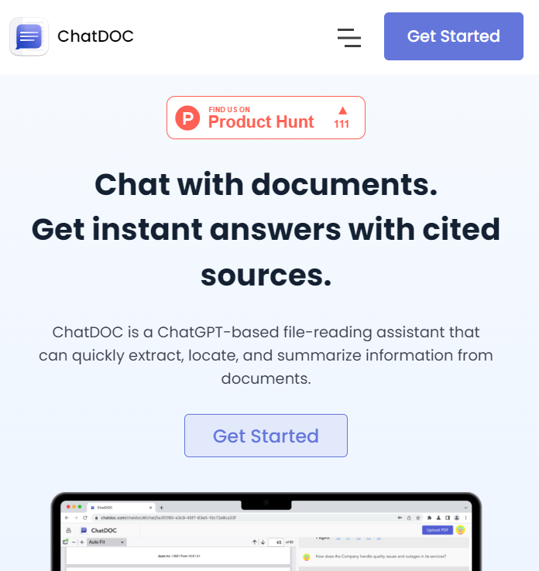
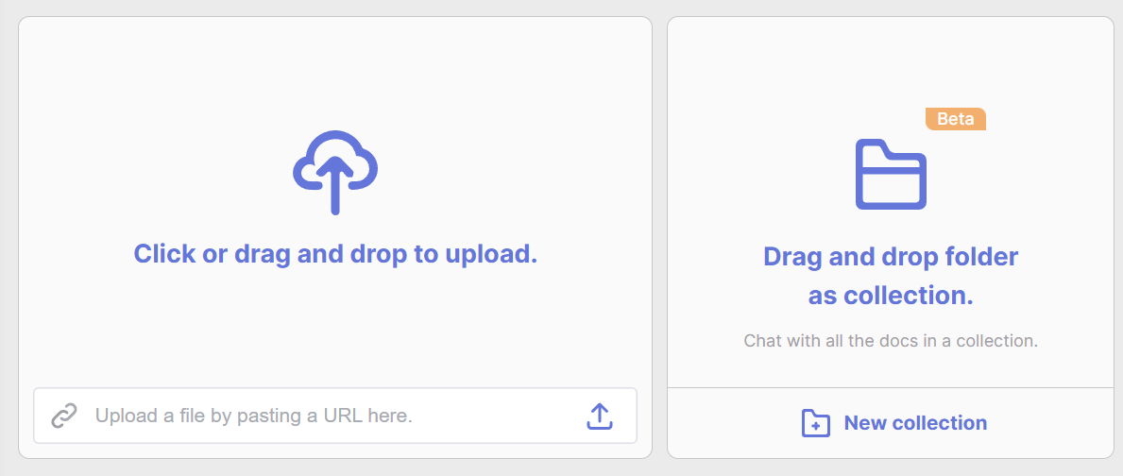
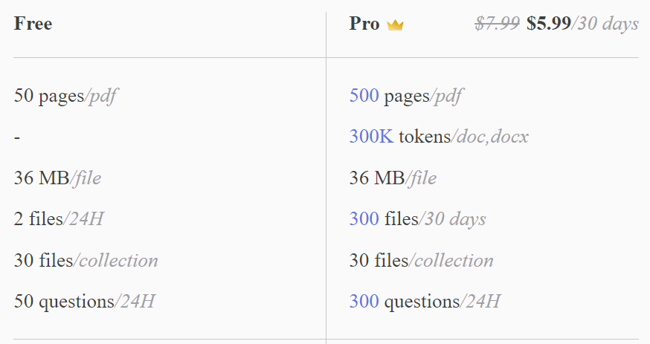
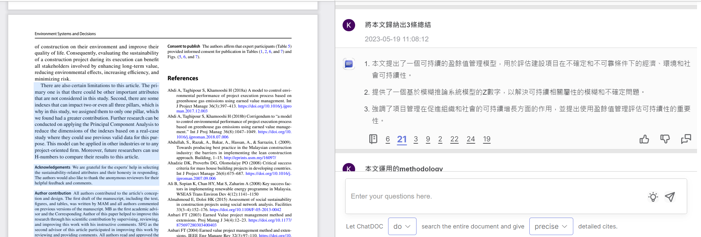
Three ways to use ChatGPT
ChatDOC
https://chatdoc.com/
Step 1：
Step 2：upload file
Step 7：Highlight of Source
Step 6：Source of this article
Step 5：Send
Step 4：Enter your Question
Step 3：Setup

Slide 10
3. Practical instructions
賴炳宏

Slide 11
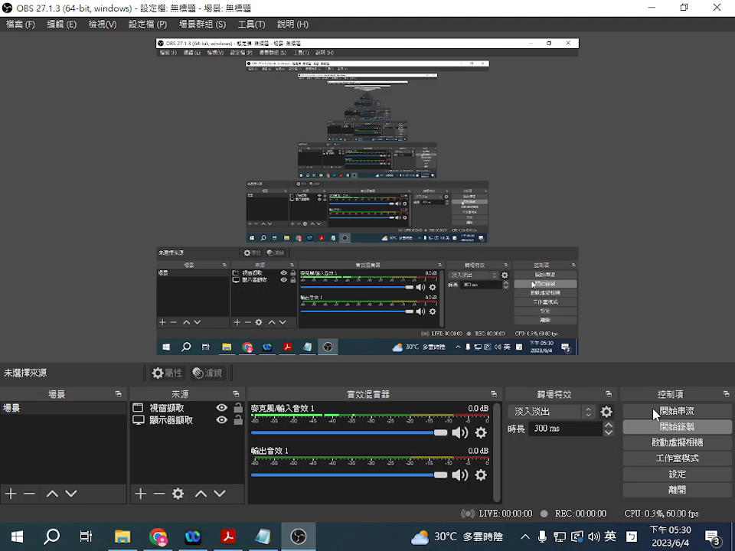
Practical instructions
ChatGPT

Slide 12

Practical instructions
ChatPDF

Slide 13
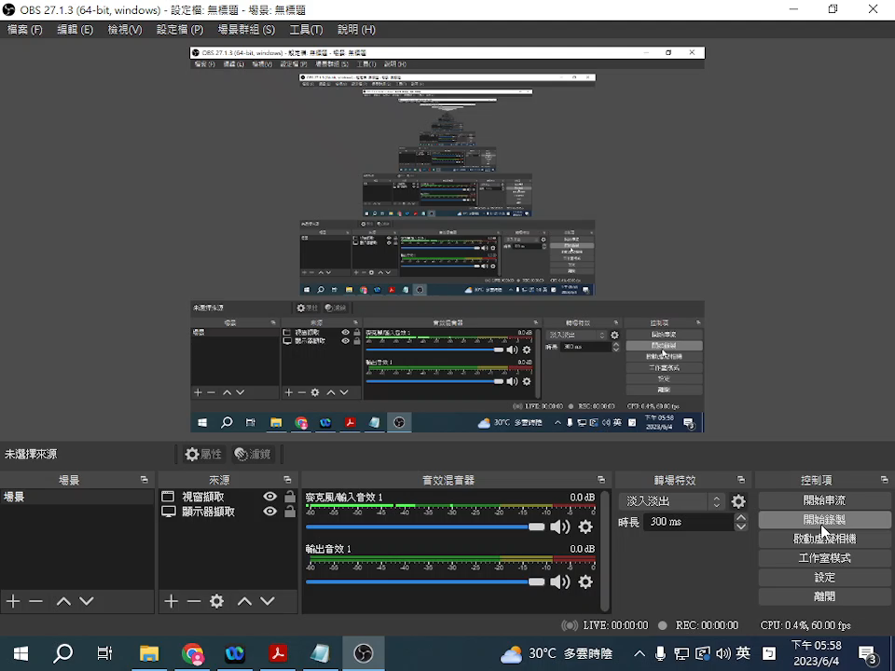
Practical instructions
ChatDOC

Slide 14
4. Advantages and disadvantages
黃聿君
Yu Jyun Huang

Slide 15
Advantages and disadvantages
Advantages
ChatGPT
Free-form conversation: ChatGPT can engage in free-form dialogue and answer a wide range of questions.
PDF document processing: ChatPDF is designed for handling PDF documents, It can extracting text, parsing structures, and answering PDF-related questions.
ChatPDF
Sources cited for fact checking : ChatDOC's responses are backed by direct citations extracted from the files. You can click and check to ensure the accuracy of AI interpretation.
ChatDoc
Query across multiple files at once : ChatDOC can consolidate the answers in multiple documents, you can acquire knowledge effortlessly through conversation.
Select tables / texts to get explanations : ChatDOC allows you to select a specific section of content from the original file, and ask targeted questions, get more accurate answers.

Slide 16
Advantages and disadvantages
Disadvantages
Potential for uncertain answers: Since ChatGPT's responses are based on statistical probabilities in its training data, it may sometimes provide uncertain or inaccurate answers.
ChatGPT
Unable to processing document : ChatGPT does not have the capability to upload and process PDF files.
Disadvantages compared to ChatDoc:
ChatPDF does not show the source of the answers and you can’t verify the accuracy of the responses.
You cannot interact with the original file in ChatPDF, it only presents a chat room interface.
ChatPDF
Format compatibility: same as ChatPDF, it may encounter issues with certain complex or special format PDF files. This may include inaccurate display of special fonts, images, or layout elements, or an inability to properly interpret and handle specific PDF functionalities.
ChatDoc

Slide 17
5. Other applications and future developments
Shirley Ngo Hong Ngoc

Slide 18
Conclusion
FUTURE DEVELOPMENTS
Enhanced Accuracy: Continual training and fine-tuning of ChatGPT using larger and more diverse datasets can help improve its accuracy and reduce instances of generating inaccurate or misleading information.
Contextual Understanding: Further advancements in natural language processing models can enable ChatGPT to better understand and contextualize complex queries, enhancing its ability to provide more accurate and relevant responses.
Multilingual Support: Expanding ChatGPT's language capabilities to include more languages can enable a wider range of users to benefit from its assistance in understanding and generating content in their preferred language.
Ethical Guidelines: Establishing clear guidelines and standards for the ethical use of ChatGPT, including guidelines for researchers, developers, and users, can ensure responsible deployment and prevent misuse of the technology.

Slide 19
Conclusion
CONCLUSION
ChatGPT's core competencies offer researchers valuable support in rapidly understanding scientific research articles. By utilizing its natural language understanding, summarization, terminology clarification, and conceptual explanation capabilities, researchers can enhance their comprehension, save time, and foster more efficient scientific inquiry.
However, this AI tool also presents few limitations, which suggests direction to future improvements. Specifically, as a text-based AI model, ChatGPT can’t directly handle document files or pictures as inputs.
With continued advancements in natural language processing and machine learning, there is still room for ChatGPT to improve its capabilities and expand its applications in the future.

Slide 20


